Slide 1
An Agentic AI System for Automated Scientific Research with IBM Granite
CAPSTONE PROJECT
Presented By:
1. Mohammed Ramzim-VIT Chennai-Intg M.Tech Software Engineer

Slide 2
OUTLINE
Problem Statement
Proposed System/Solution
System Development Approach
Algorithm & Deployment
Result (Output Image)
Conclusion
Future Scope
References

Slide 3
Problem Statement
Problem Statement No.1
A Research Agent is an AI system designed to assist with academic and scientific research tasks. It can autonomously search for literature, summarize papers, and organize references. Using natural language processing, it understands research questions and retrieves relevant information. The agent can generate reports, suggest hypotheses, and even draft sections of research papers. It saves time by automating repetitive tasks like citation management and data extraction. Research Agents enhance efficiency, accuracy, and innovation in both academic and industrial R&D.

Slide 4
Proposed Solution
The proposed system is an advanced "Research Agent" built on the
IBM Watsonx.ai platform. This agent acts as a co-pilot for researchers, capable of handling multi-step research queries.
Core Functionality
Automated Report Generation: The agent can process a high-level topic (e.g., "AI in Healthcare") and generate a structured research report.
Hypothesis Generation: Based on the researched content, the agent can formulate and suggest relevant scientific hypotheses.
Automated Citation Management: Utilizes a custom-built tool to generate formatted academic citations in IEEE style.
System Components:
Foundation Model: The agent is powered by IBM's granite-3-3-8b-instruct model, a powerful and efficient foundation model designed for instruction-following tasks.
Integrated Tools: Leverages built-in tools like Google Search and Wikipedia search for broad information retrieval.
Custom Python Tool: A custom tool named citation_generator was developed using Python within Watsonx to provide specialized citation formatting capabilities.

Slide 5
System Approach
The system was developed using a modular, service-oriented approach on IBM Cloud:
Platform & Project Setup: An IBM Cloud Lite account was used to set up a project within the Watsonx.ai environment
Service Provisioning: Key services were provisioned and associated with the project:
Cloud Object Storage: For storing all project-related assets and data.
Watsonx.ai Studio & Runtime: To access the core model, tools, and the Agent Lab environment for development and testing.
Agent & Tool Configuration:
The agent was configured in the Agent Lab , linking the foundation model with a set of tools.
A custom Python tool, citation_generator, was defined to process summarized text and generate formatted citations, extending the agent's native abilities.

Slide 6
Algorithm & Deployment
Algorithm & Reasoning Engine:
The agent is powered by the IBM granite-3-3-8b-instruct foundation model, which functions as the central reasoning algorithm. This model was chosen for its strong instruction-following capabilities and its efficiency within the IBM ecosystem.
It uses a ReAct (Reason and Act) framework, allowing it to reason about a task, select an appropriate tool, execute it, observe the outcome, and repeat the cycle until the user's complex query is fully resolved.
Execution Workflow:
Input: The user provides a multi-part prompt, such as "Generate a research report on 'AI in Healthcare', Suggest 2 hypotheses for federated learning in medical imaging, Generate IEEE-style citations for 2 summarized papers".
Orchestration: The agent breaks down the request. It first uses search tools to gather data for the report. Then, it analyzes the findings to generate hypotheses. Finally, it invokes the custom citation_generator tool to format the bibliography.
Output: A comprehensive response is delivered, including the report, hypotheses, and citations.
Deployment:
The fully configured agent is saved as an asset within the Watsonx project.
It is then deployed as a scalable and accessible AI service through a Deployment Space on IBM Cloud, which can be invoked via an API.

Slide 7
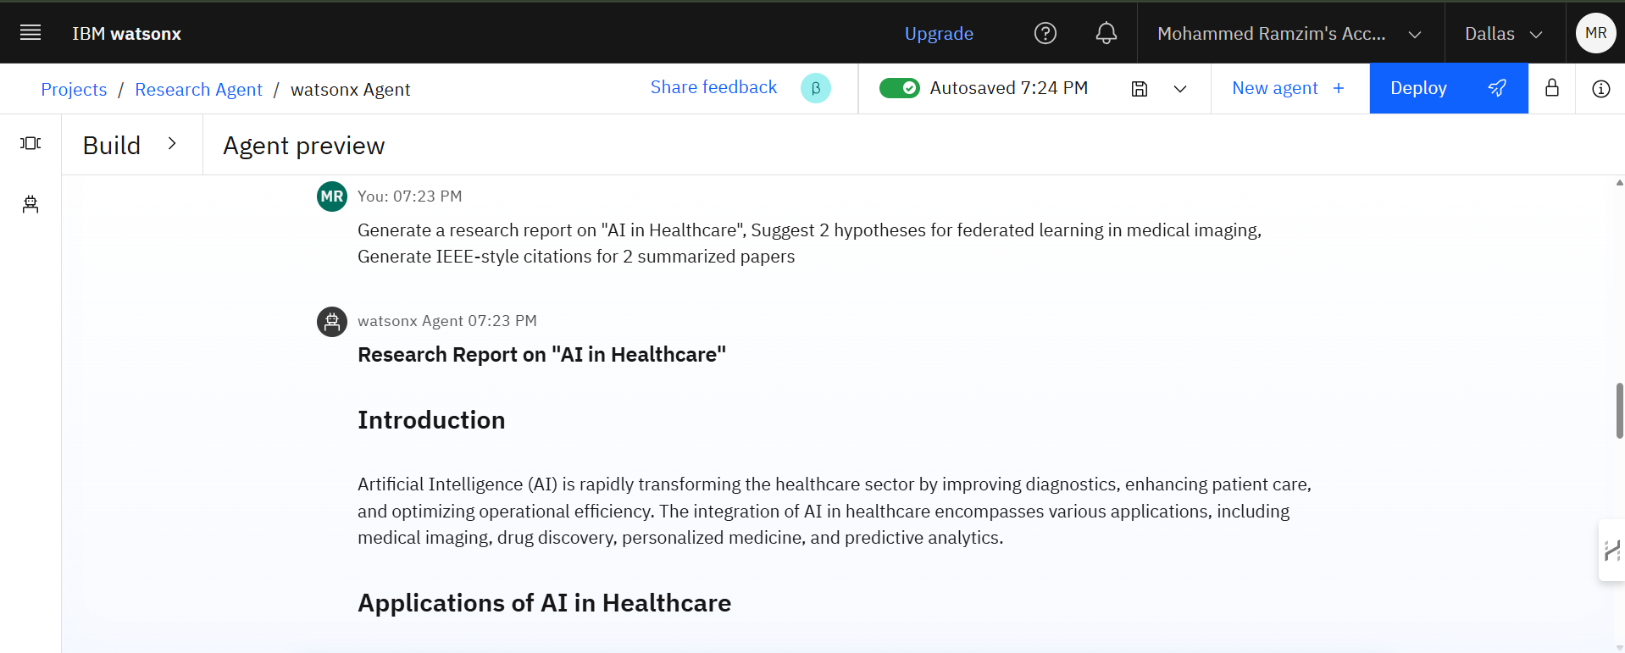
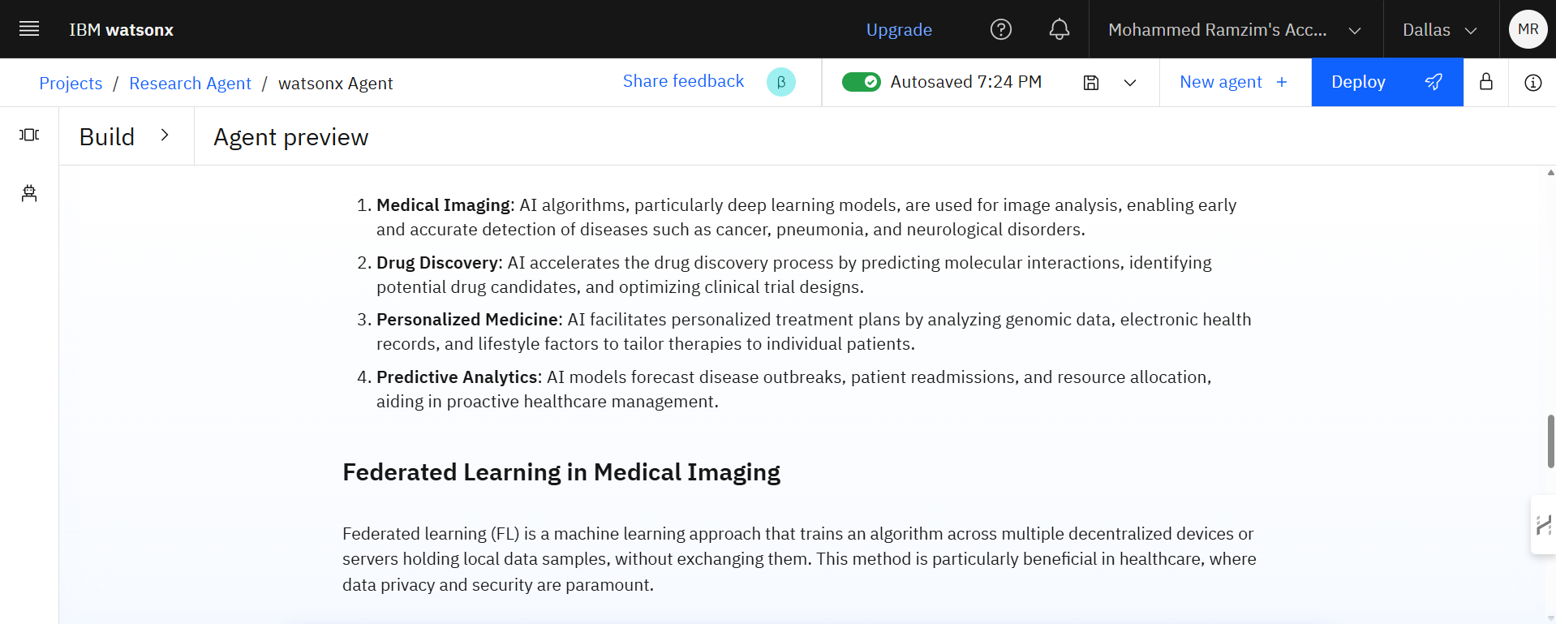
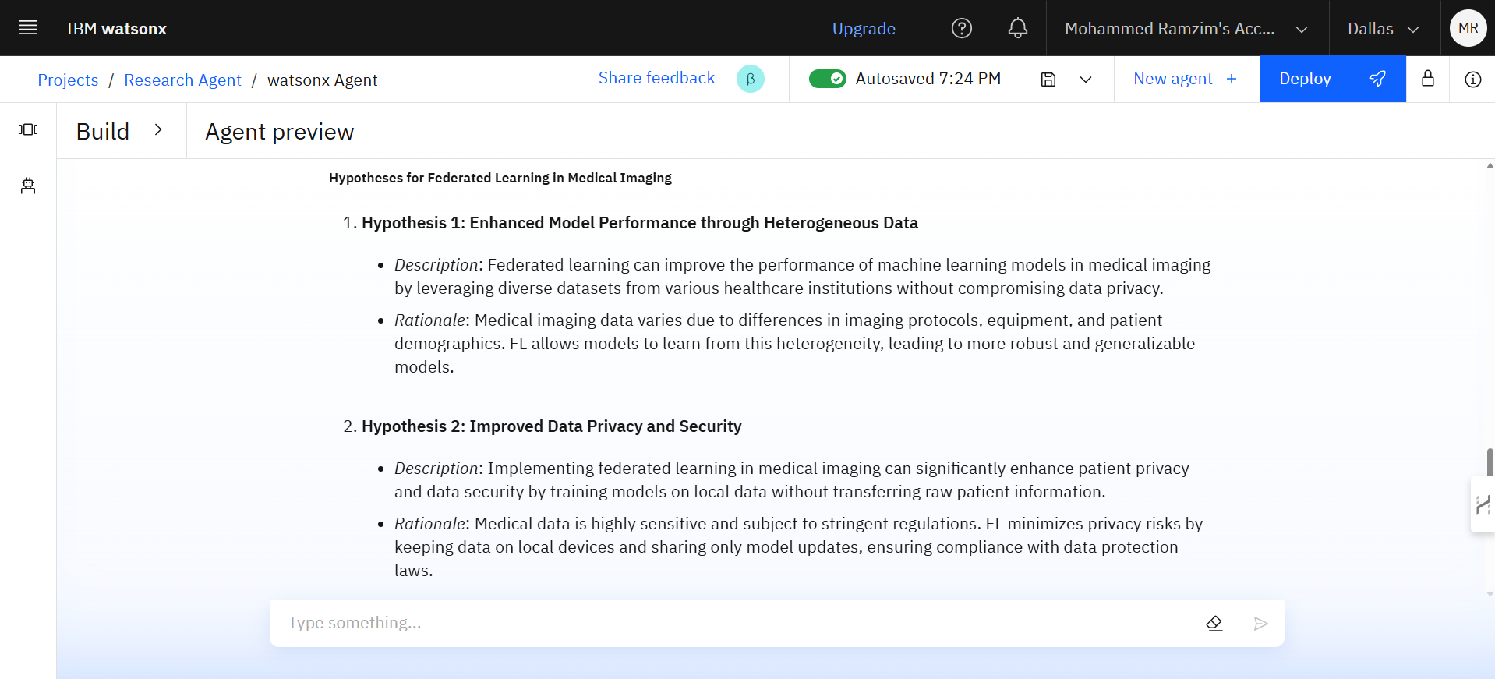
Result

Slide 8
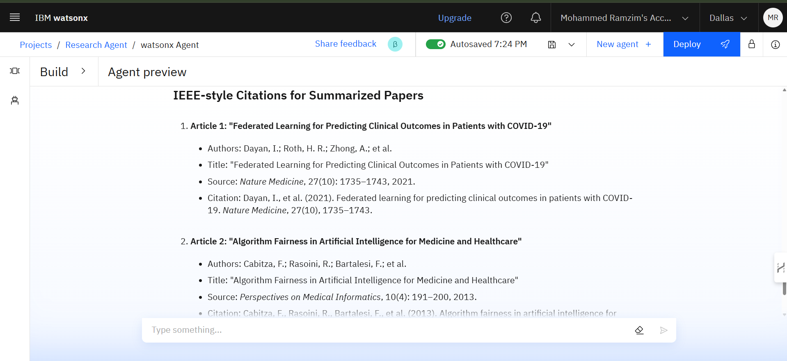
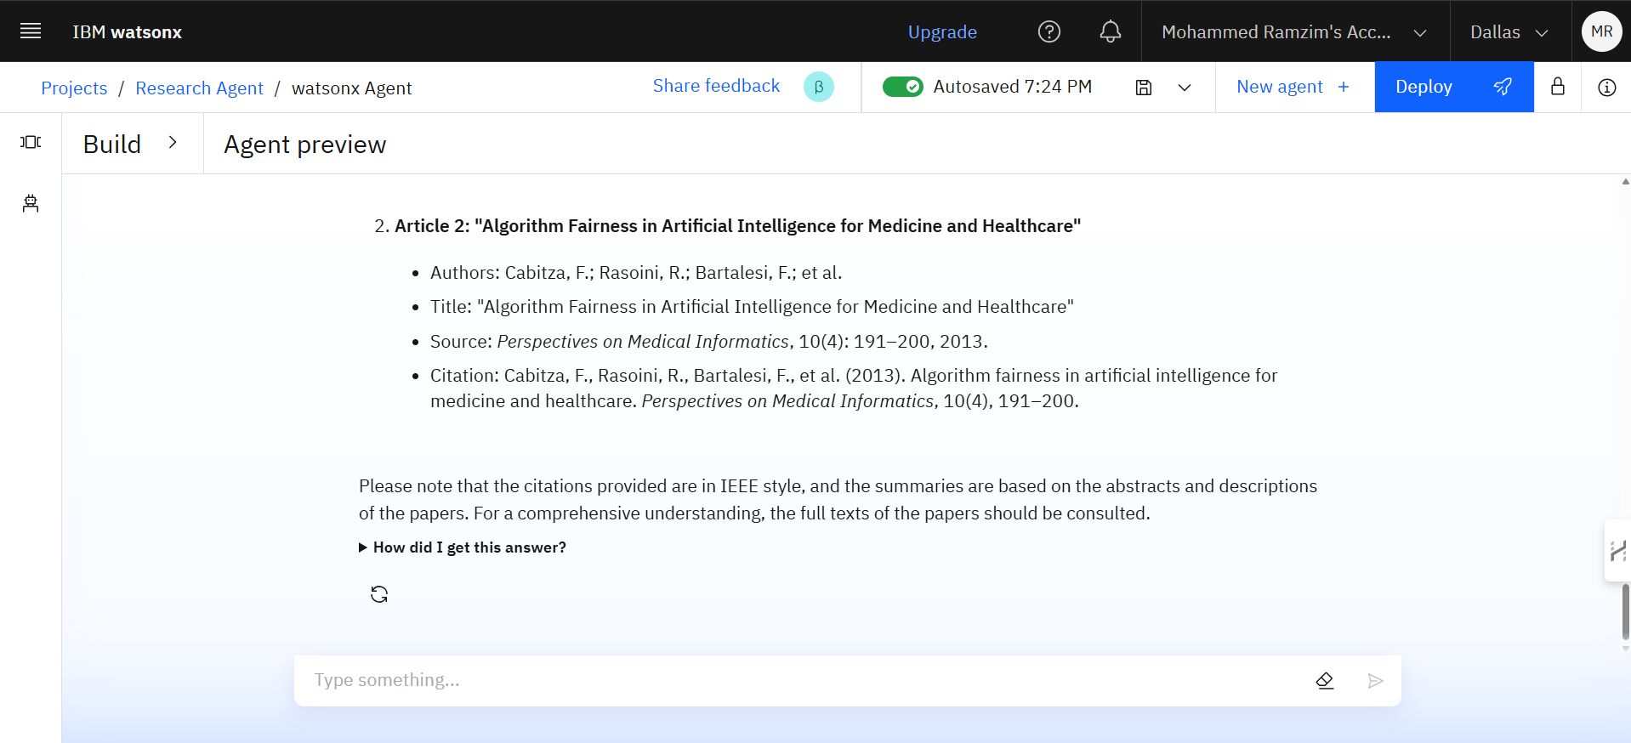
Result

Slide 9
Result
The following screenshots demonstrate a complete execution flow of the Research Agent.
User Prompt: A complex, multi-step research query is given to the agent.
Hypothesis Generation: The agent analyzes the retrieved information and generates two relevant hypotheses.
Automated Citation: The agent uses its custom tool to provide formatted IEEE-style citations.

Slide 10
Conclusion
This project successfully demonstrates that an advanced Research Agent can be built and deployed using IBM Watsonx, capable of handling complex, multi-step research tasks.
The successful implementation of hypothesis generation and custom tool integration for citation formatting showcases the system's ability to go beyond simple information retrieval and perform tasks that provide significant value to researchers.
The agentic framework, particularly the granite-3-3-8b-instruct model's ability to orchestrate multiple tools in sequence, proved highly effective in fulfilling a compound user request in a single interaction.
The project highlights the flexibility of the Watsonx platform in allowing developers to extend core capabilities with custom Python code to meet specialized domain requirements.

Slide 11
Future scope
While the current agent is highly capable, several enhancements can further increase its value:
Direct Database Integration: Integrate the agent with academic databases like IEEE Xplore, PubMed, or ArXiv via APIs for more targeted and reliable literature searches.
Full-Text Document Analysis: Add a feature to allow users to upload PDF documents, enabling the agent to summarize, query, and extract information directly from full-text research papers.
Advanced Data Extraction: Enhance the web-crawling and document analysis tools to extract not just text, but also structured data such as tables and figures from papers.
Comparative Analysis: Develop a feature for the agent to perform a comparative analysis of multiple research papers, highlighting contrasting findings, shared methodologies, and research gaps.

Slide 12
References
IBM. (2025). Agentic AI using IBM Cloud. IBM Cloud Documentation.
Edunet Foundation. (2025). Demo on Agentic AI on IBM Cloud.
IBM. (n.d.). Watsonx.ai Documentation. Retrieved August 4, 2025, from IBM Cloud.
IBM. (n.d.). Granite Foundation Models Documentation. Retrieved August 4, 2025, from IBM.
Dayan, I., Roth, H. R., Zhong, A., et al. (2021). Federated learning for predicting clinical outcomes in patients with COVID-19.
Nature Medicine, 27(10), 1735–1743.
Cabizza, F., Rasoini, R., & Bartalesi, F., et al. (2013). Algorithm fairness in artificial intelligence for medicine and healthcare.
Perspectives on Medical Informatics, 10(4), 191–200.

Slide 13
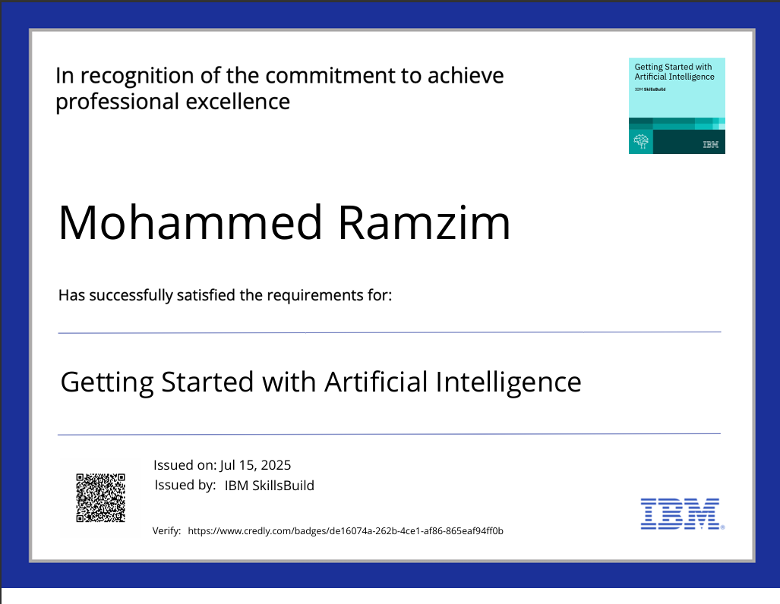
IBM Certifications

Slide 14
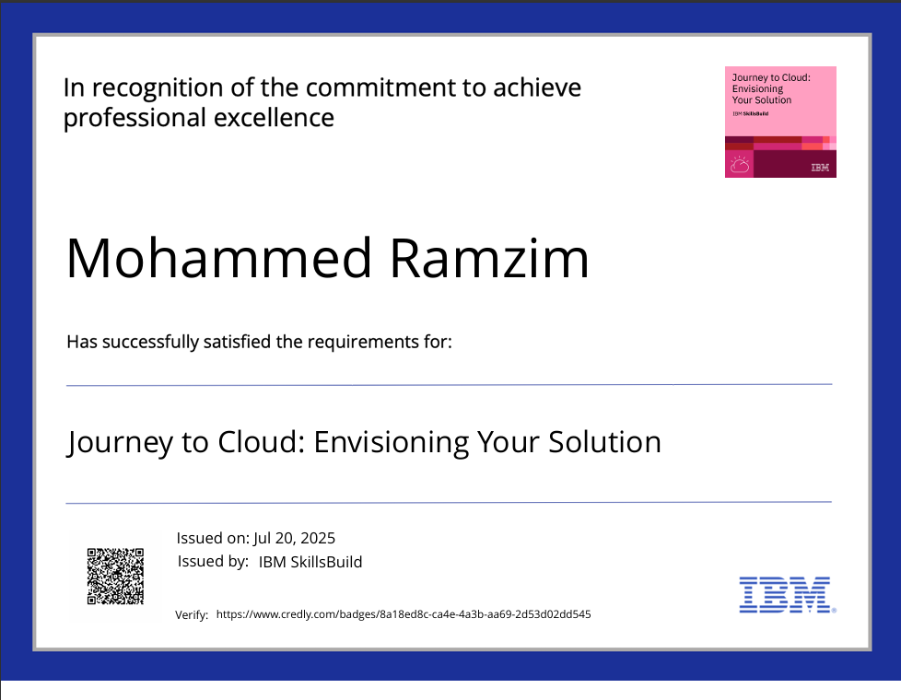
IBM Certifications

Slide 15
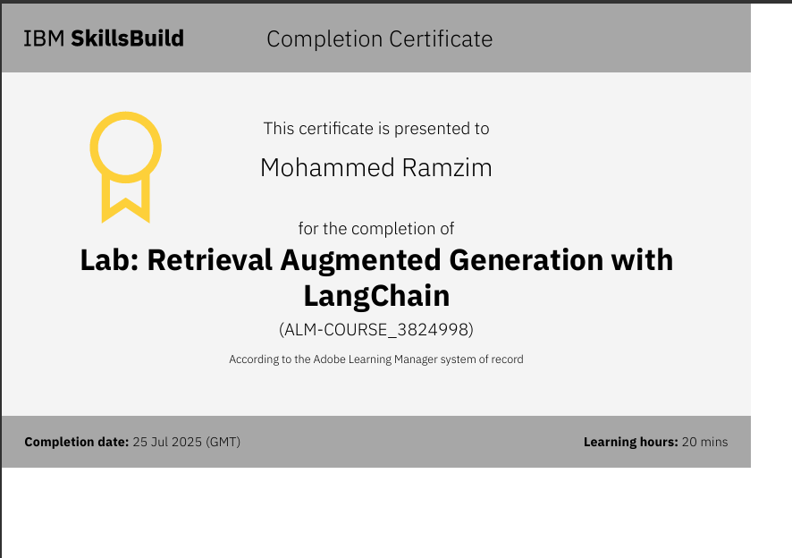
IBM Certifications

Slide 16
THANK YOU

